Slide 1




Bibliography Analysis of Marketing Analytics & Family Businesses
Using Data from Scopus and Visual Mapping with VOSviewer

Slide 2
Keywords for Our Analysis
marketing analytics
and
family business, family businesses, family enterprise, family enterprises

Slide 3
Methodology
Data Source: Data was collected from Scopus using specific keywords. Keywords Used: Marketing Analytics Family Business, Family Businesses, Family Enterprise, Family Enterprises tools.
VOS viewer as the tool used for creating co-authorship, co-citation, and keyword co-occurrence maps. Analysis Type: Bibliographic couplings-authorship analysis Keyword co-occurrence analysis

Slide 4
VOSviewer Maps Overview
Type of analysis and Unit of analysis
Co-authorship and Organization
Co-occurrence and All keywords
Citation and organization
Bibliographic coupling and Countries
Co-Citation and Cited References

Slide 5
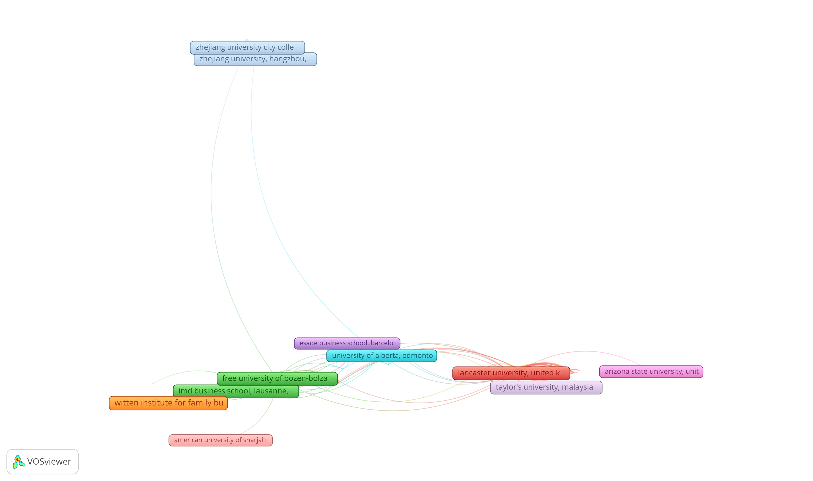
Co-authorship and Organization Network Visualization

Slide 6
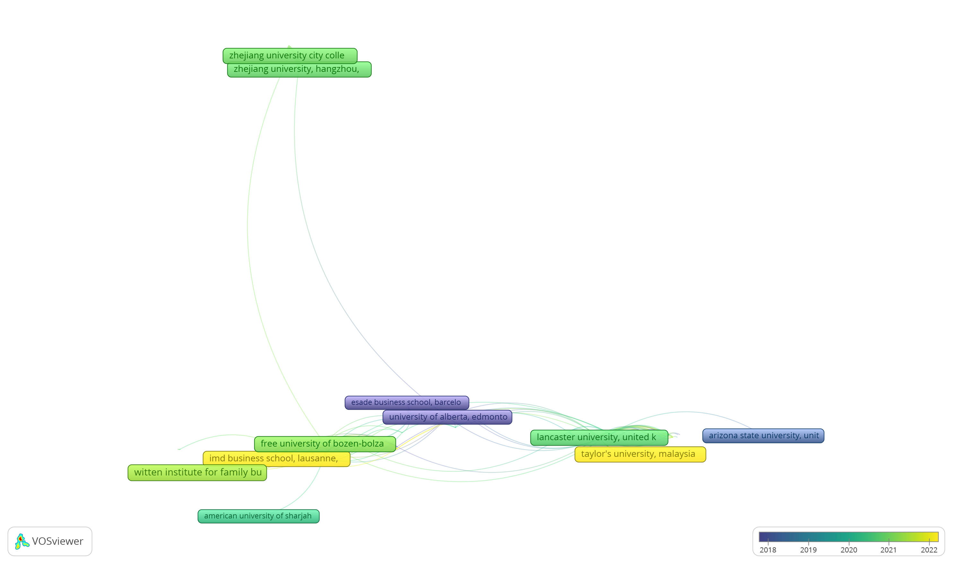
Co-authorship and Organization Overlay Visualization

Slide 7
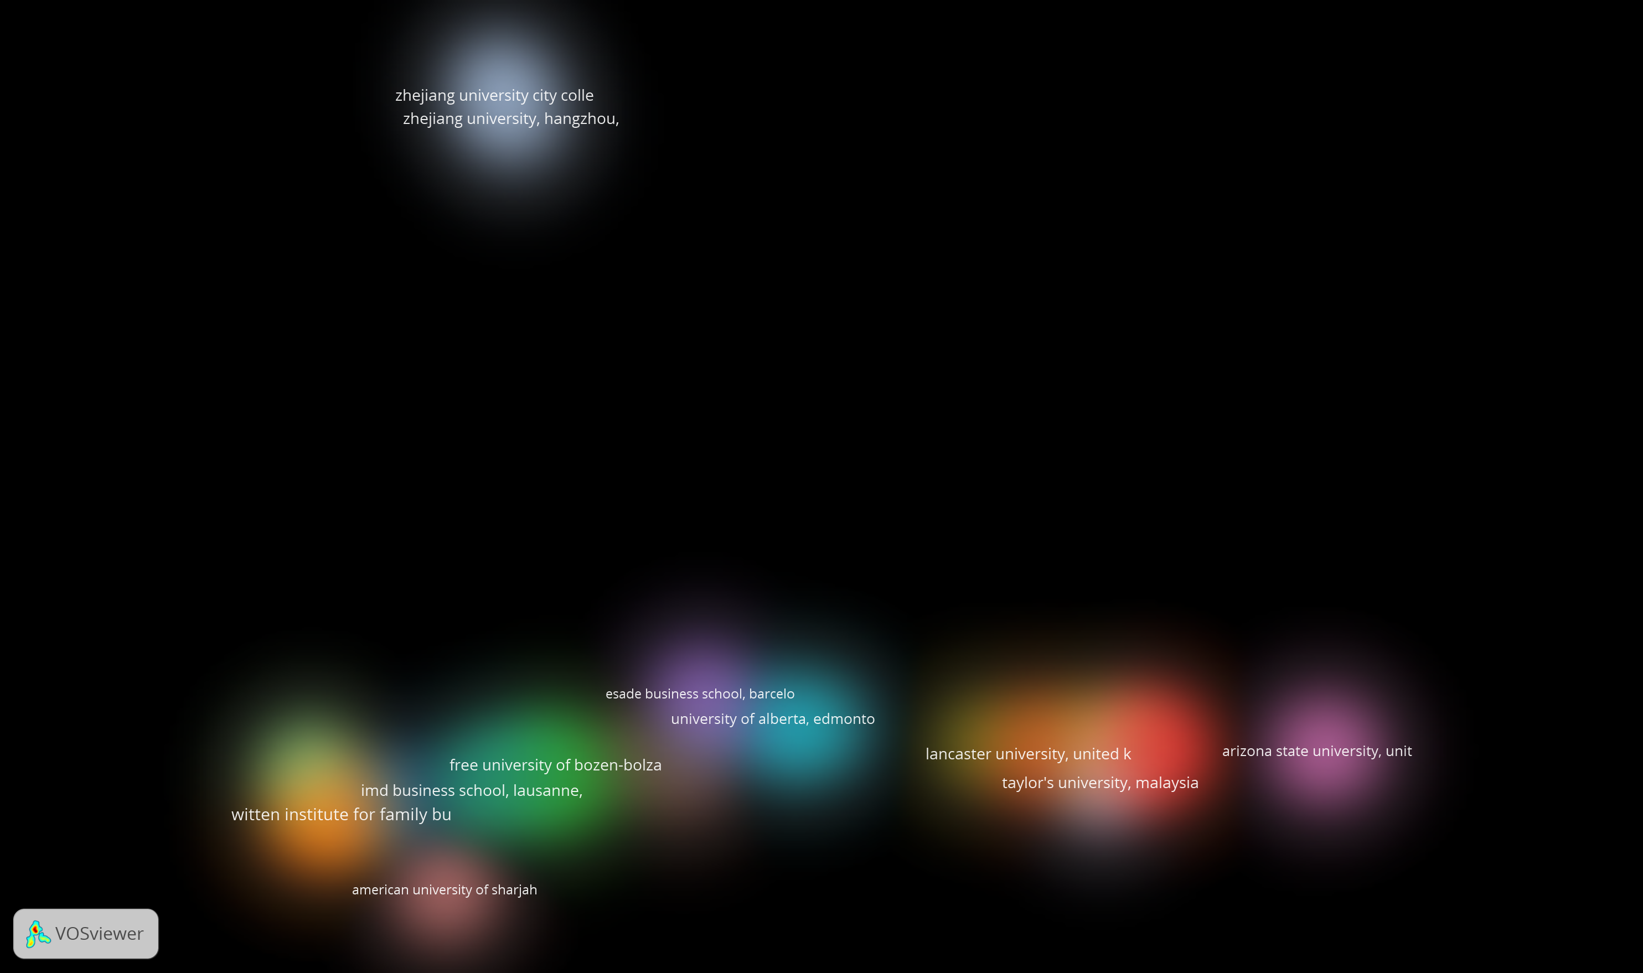
Co-authorship and Organization Density Visualization

Slide 8
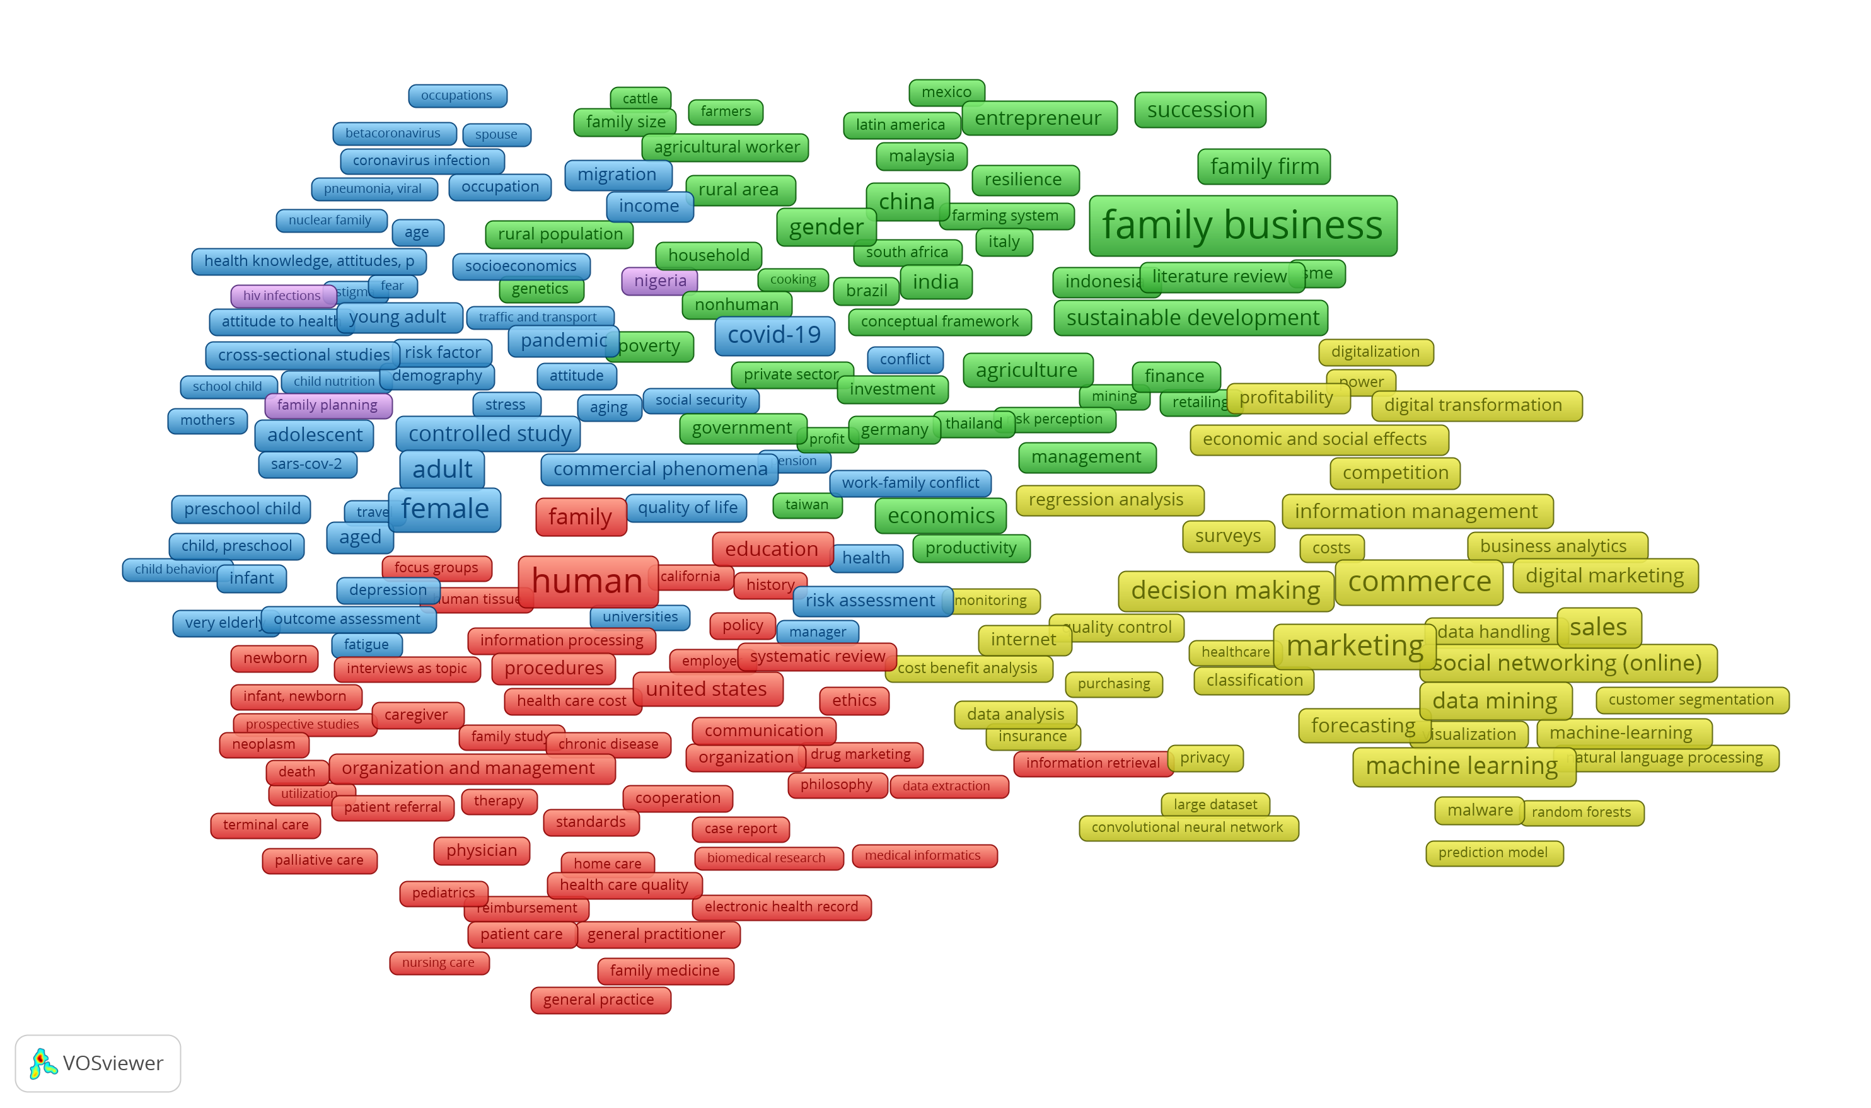
Co-occurrence and All keywords Network Visualization

Slide 9
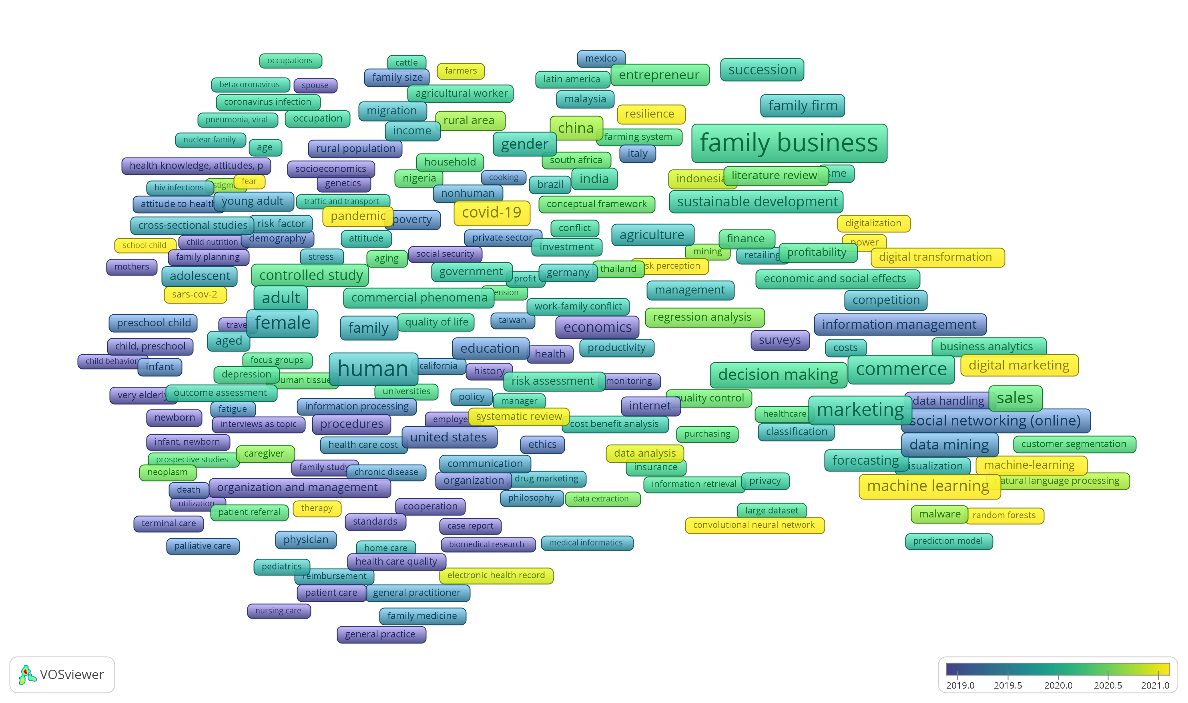
Co-occurrence and All keywords Overlay Visualization

Slide 10
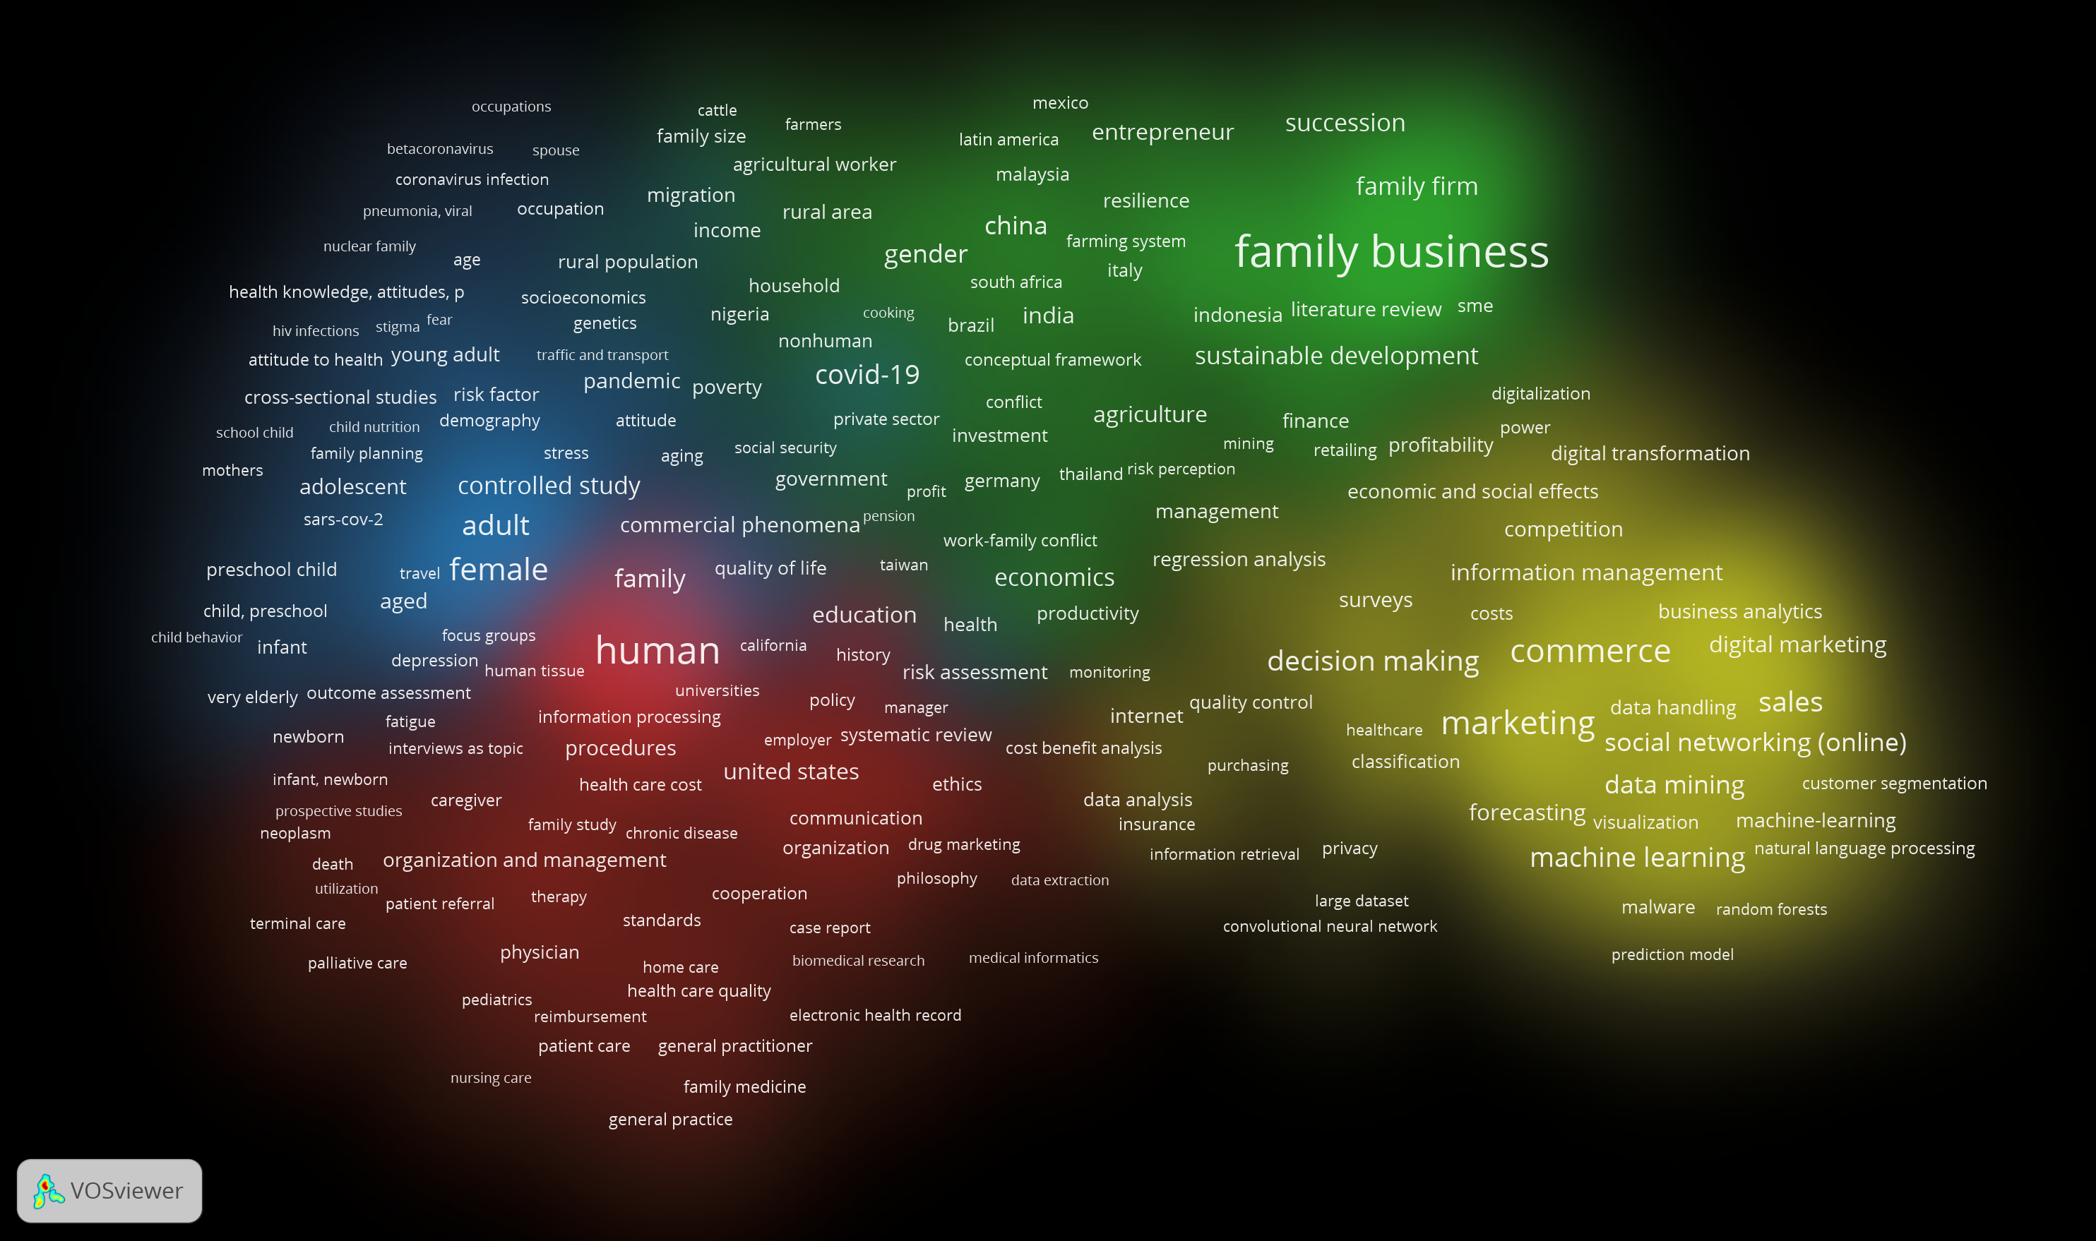
Co-occurrence and All keywords Density Visualization

Slide 11
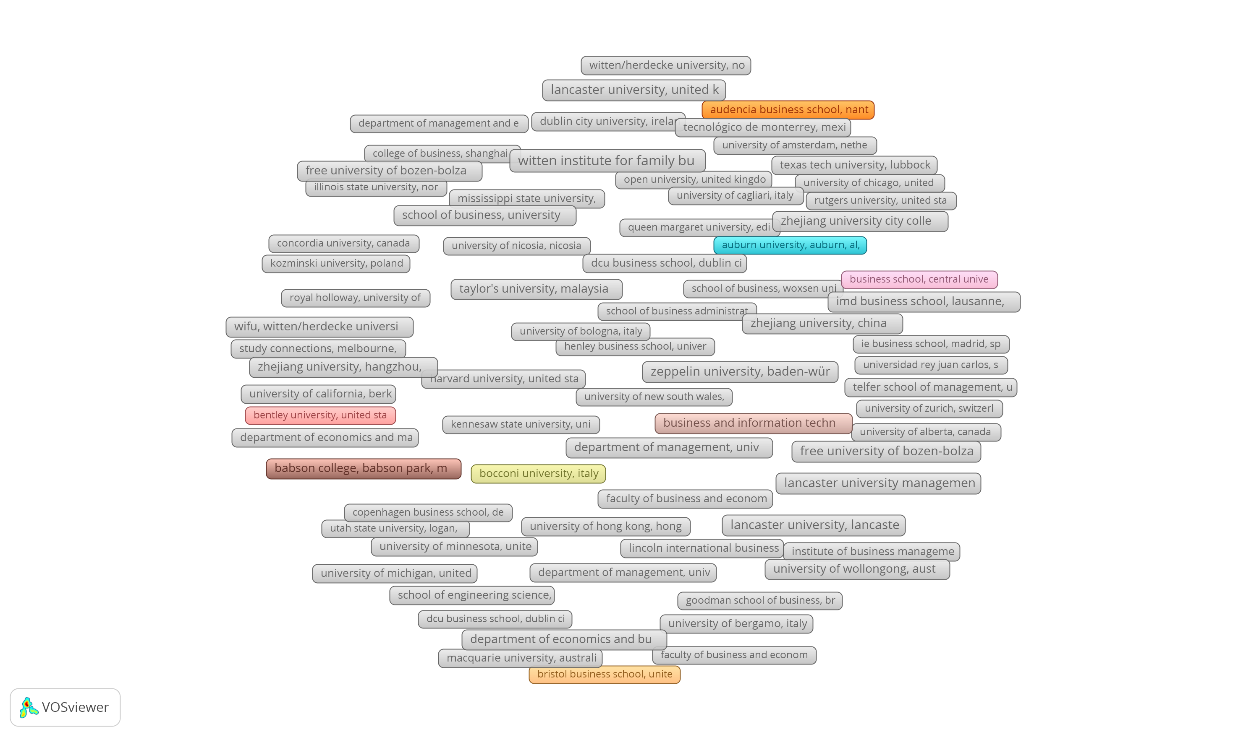
Citation and organization Network Visualization

Slide 12
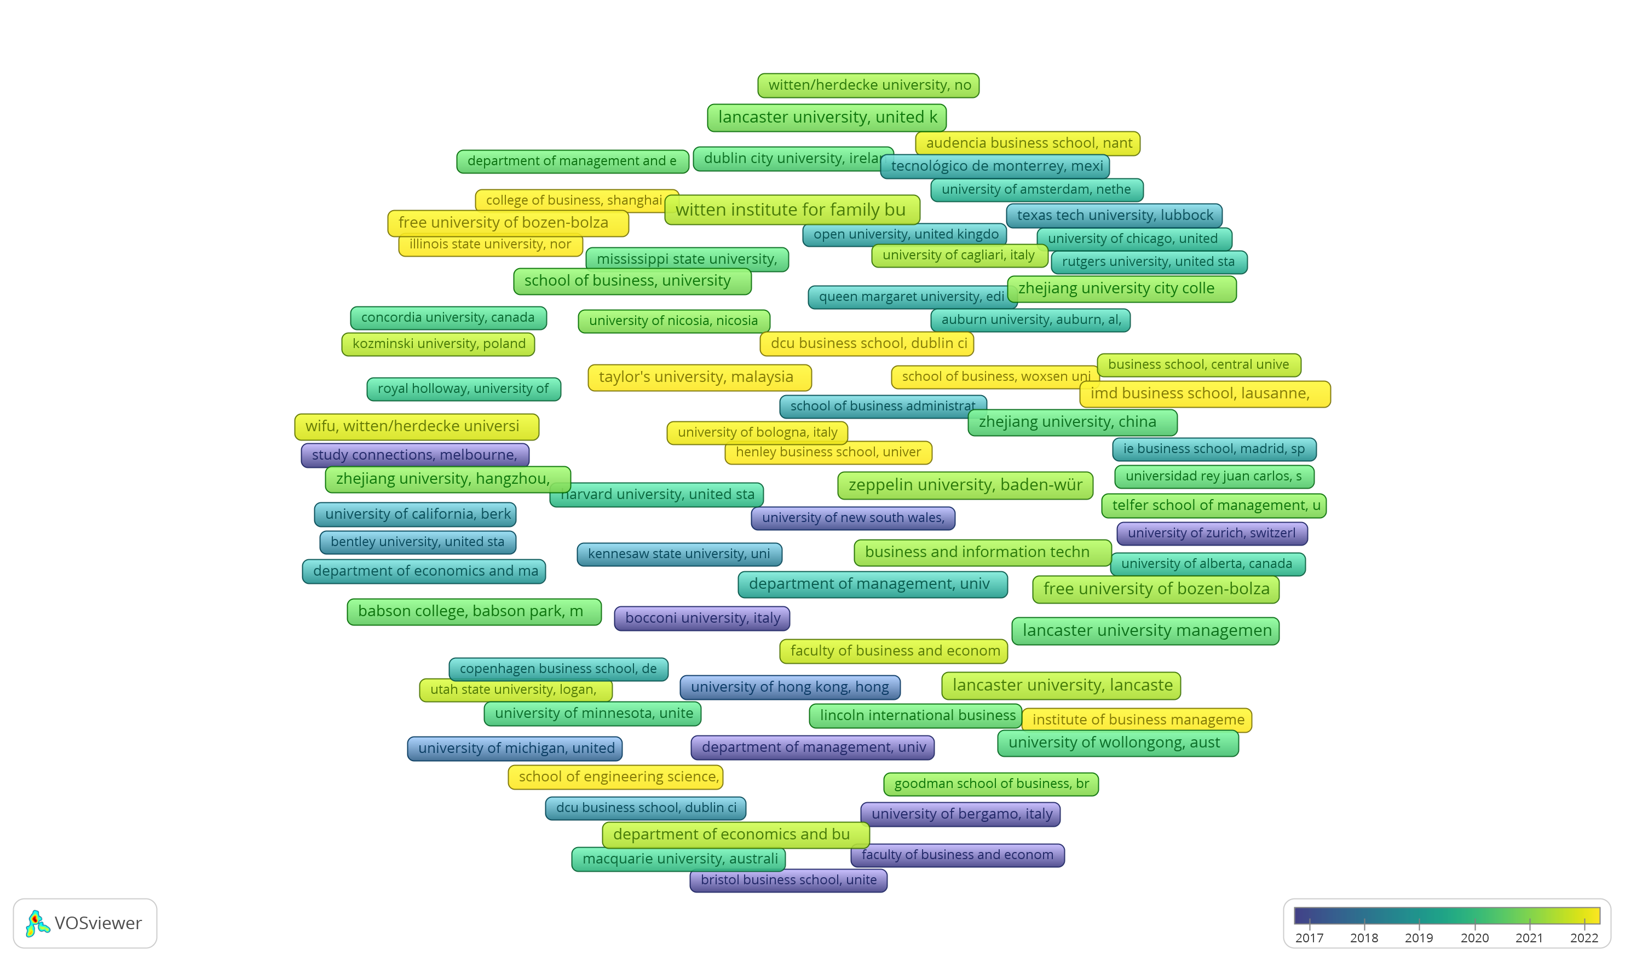
Citation and organization Overlay Visualization

Slide 13
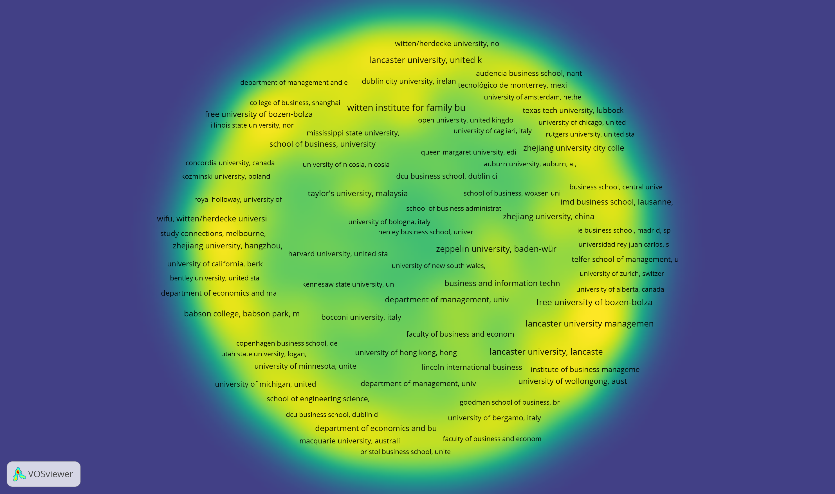
Citation and organization Density Visualization

Slide 14
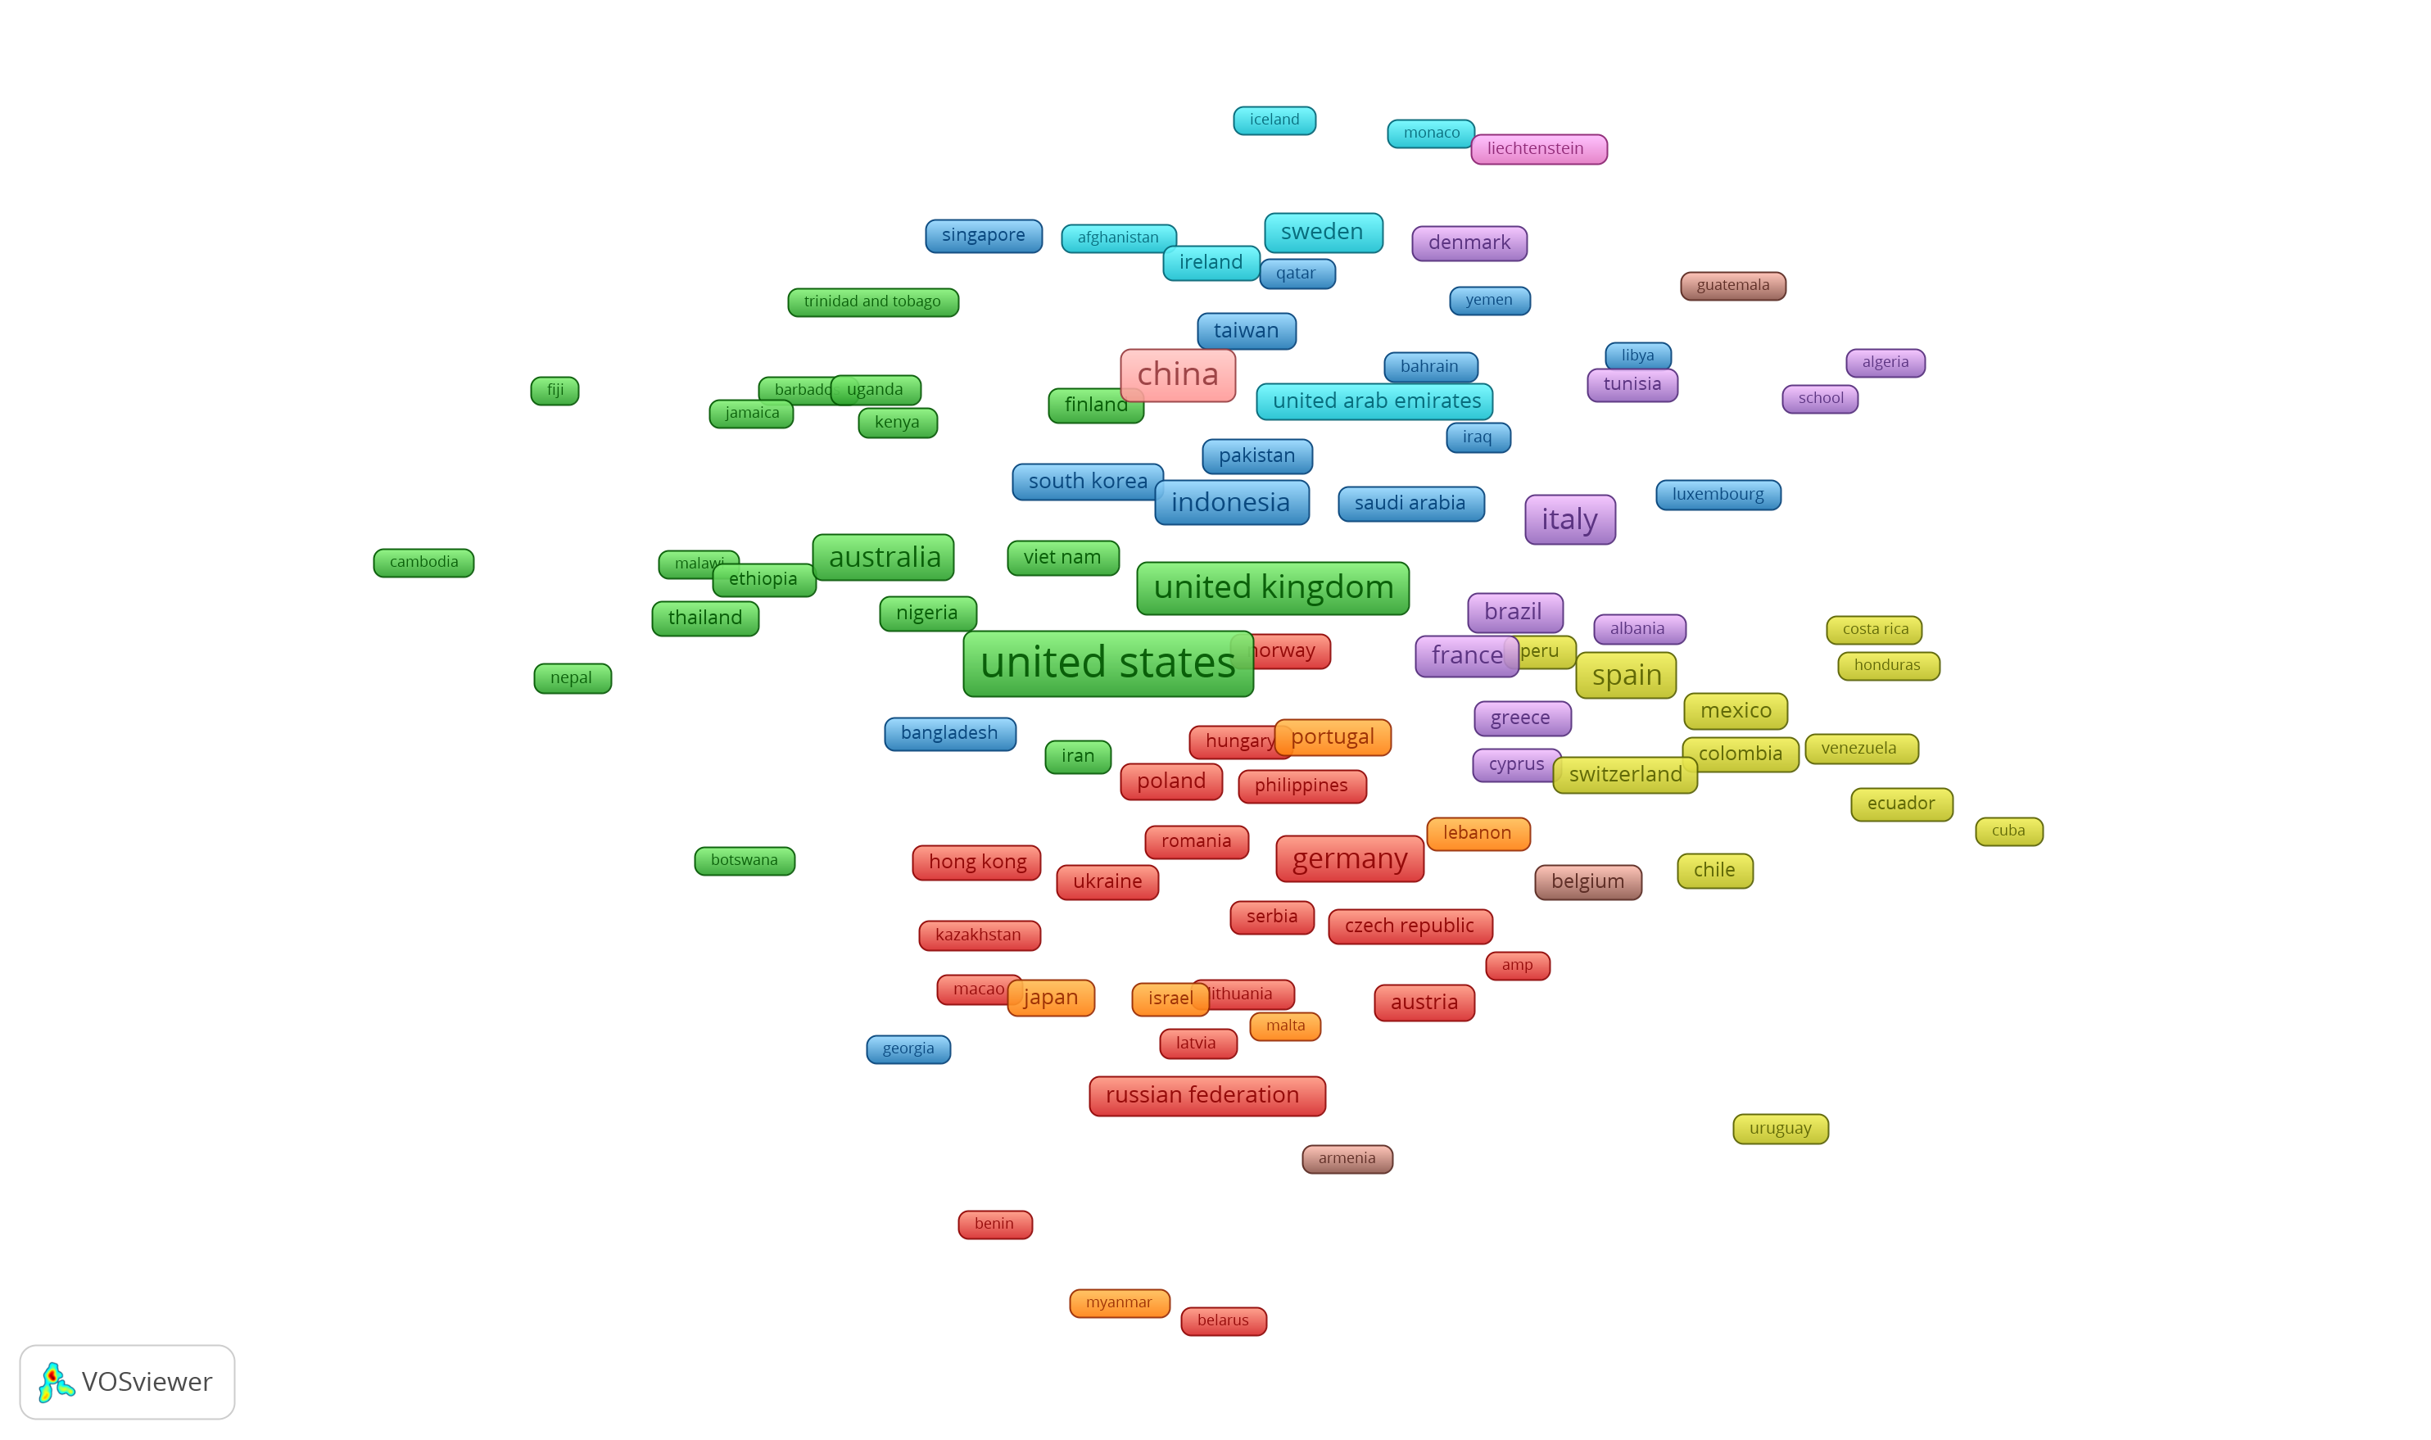
Bibliographic coupling and Countries Network Visualization

Slide 15
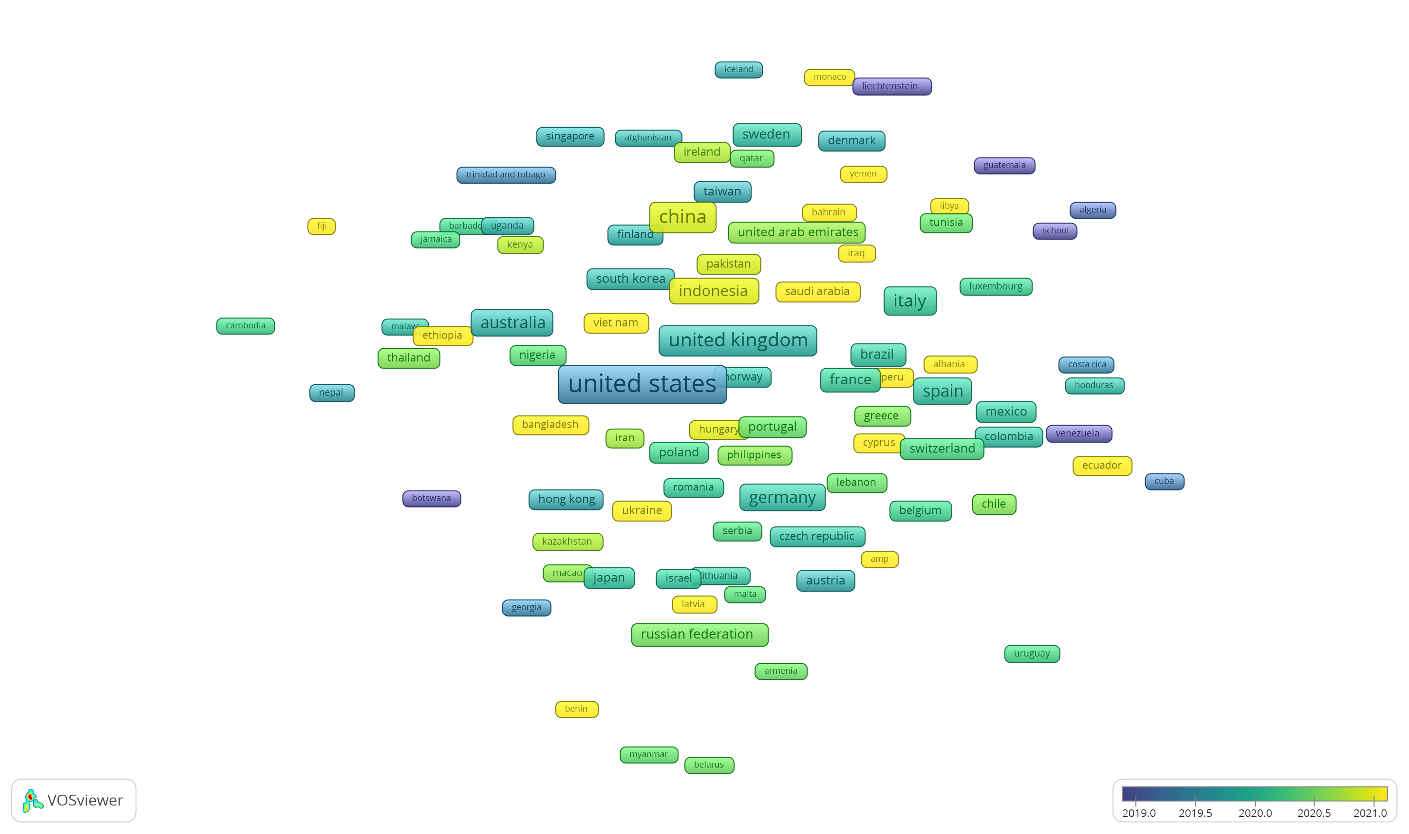
Bibliographic coupling and Countries Overlay Visualization

Slide 16
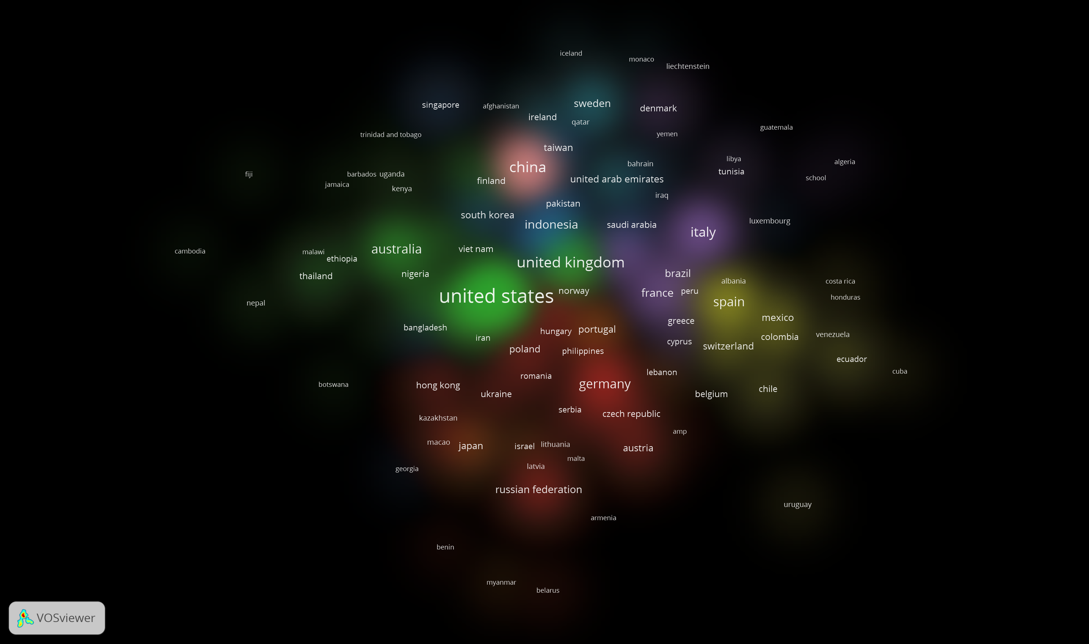
Co-Citation and Cited References Density Visualization

Slide 17
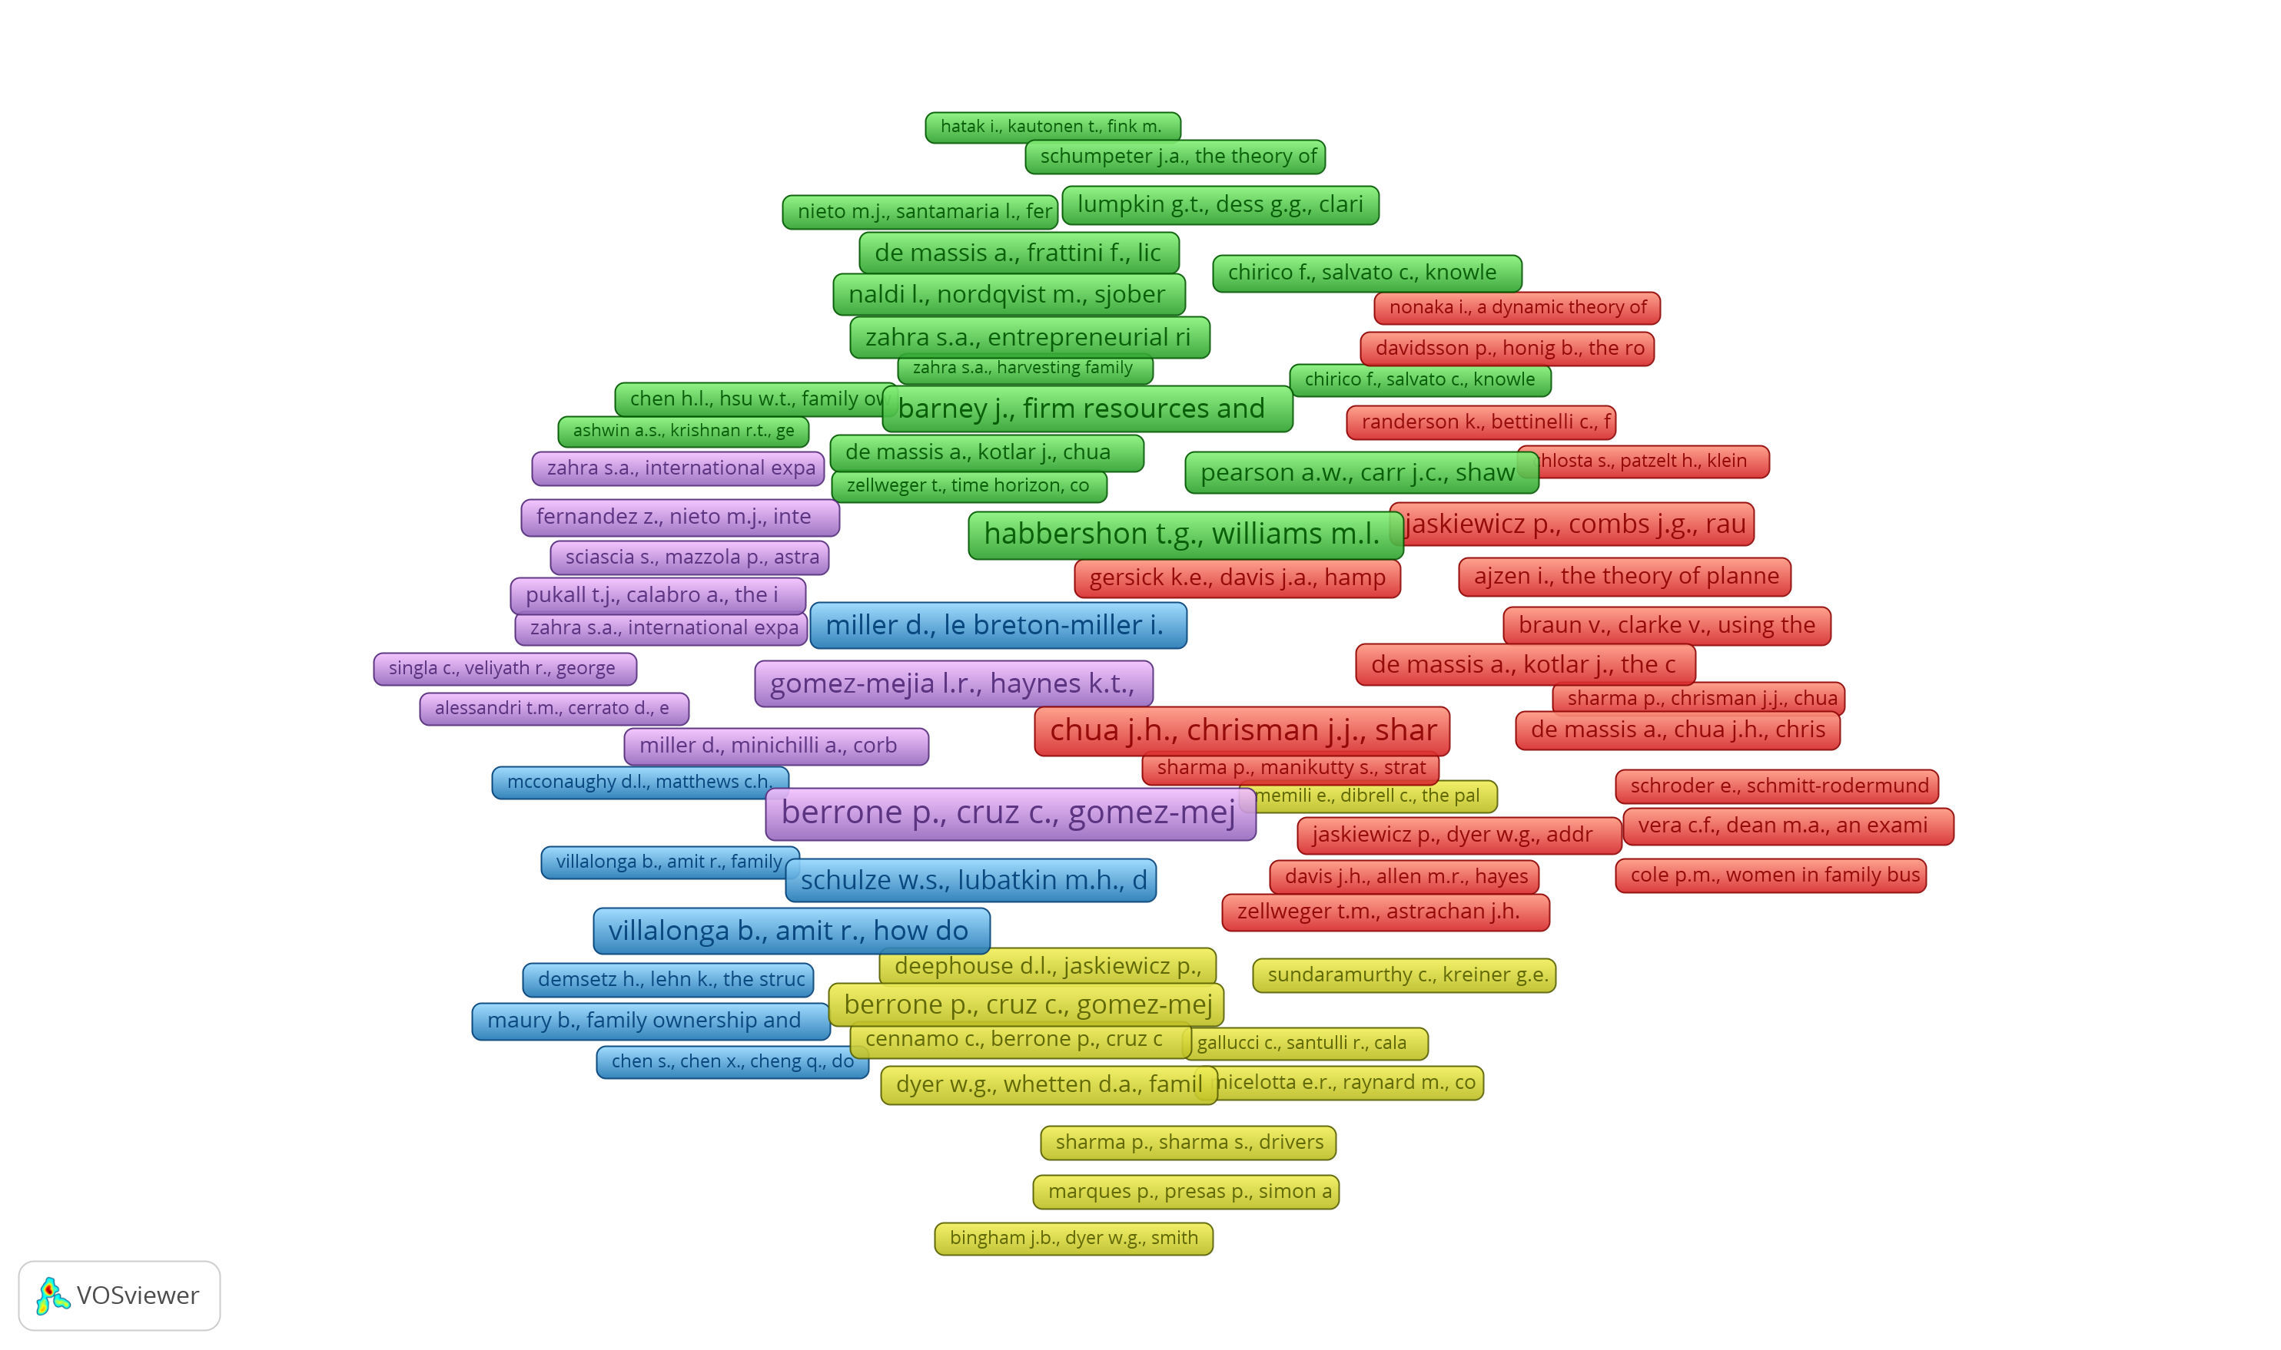
Co-Citation and Cited References Network Visualization

Slide 18
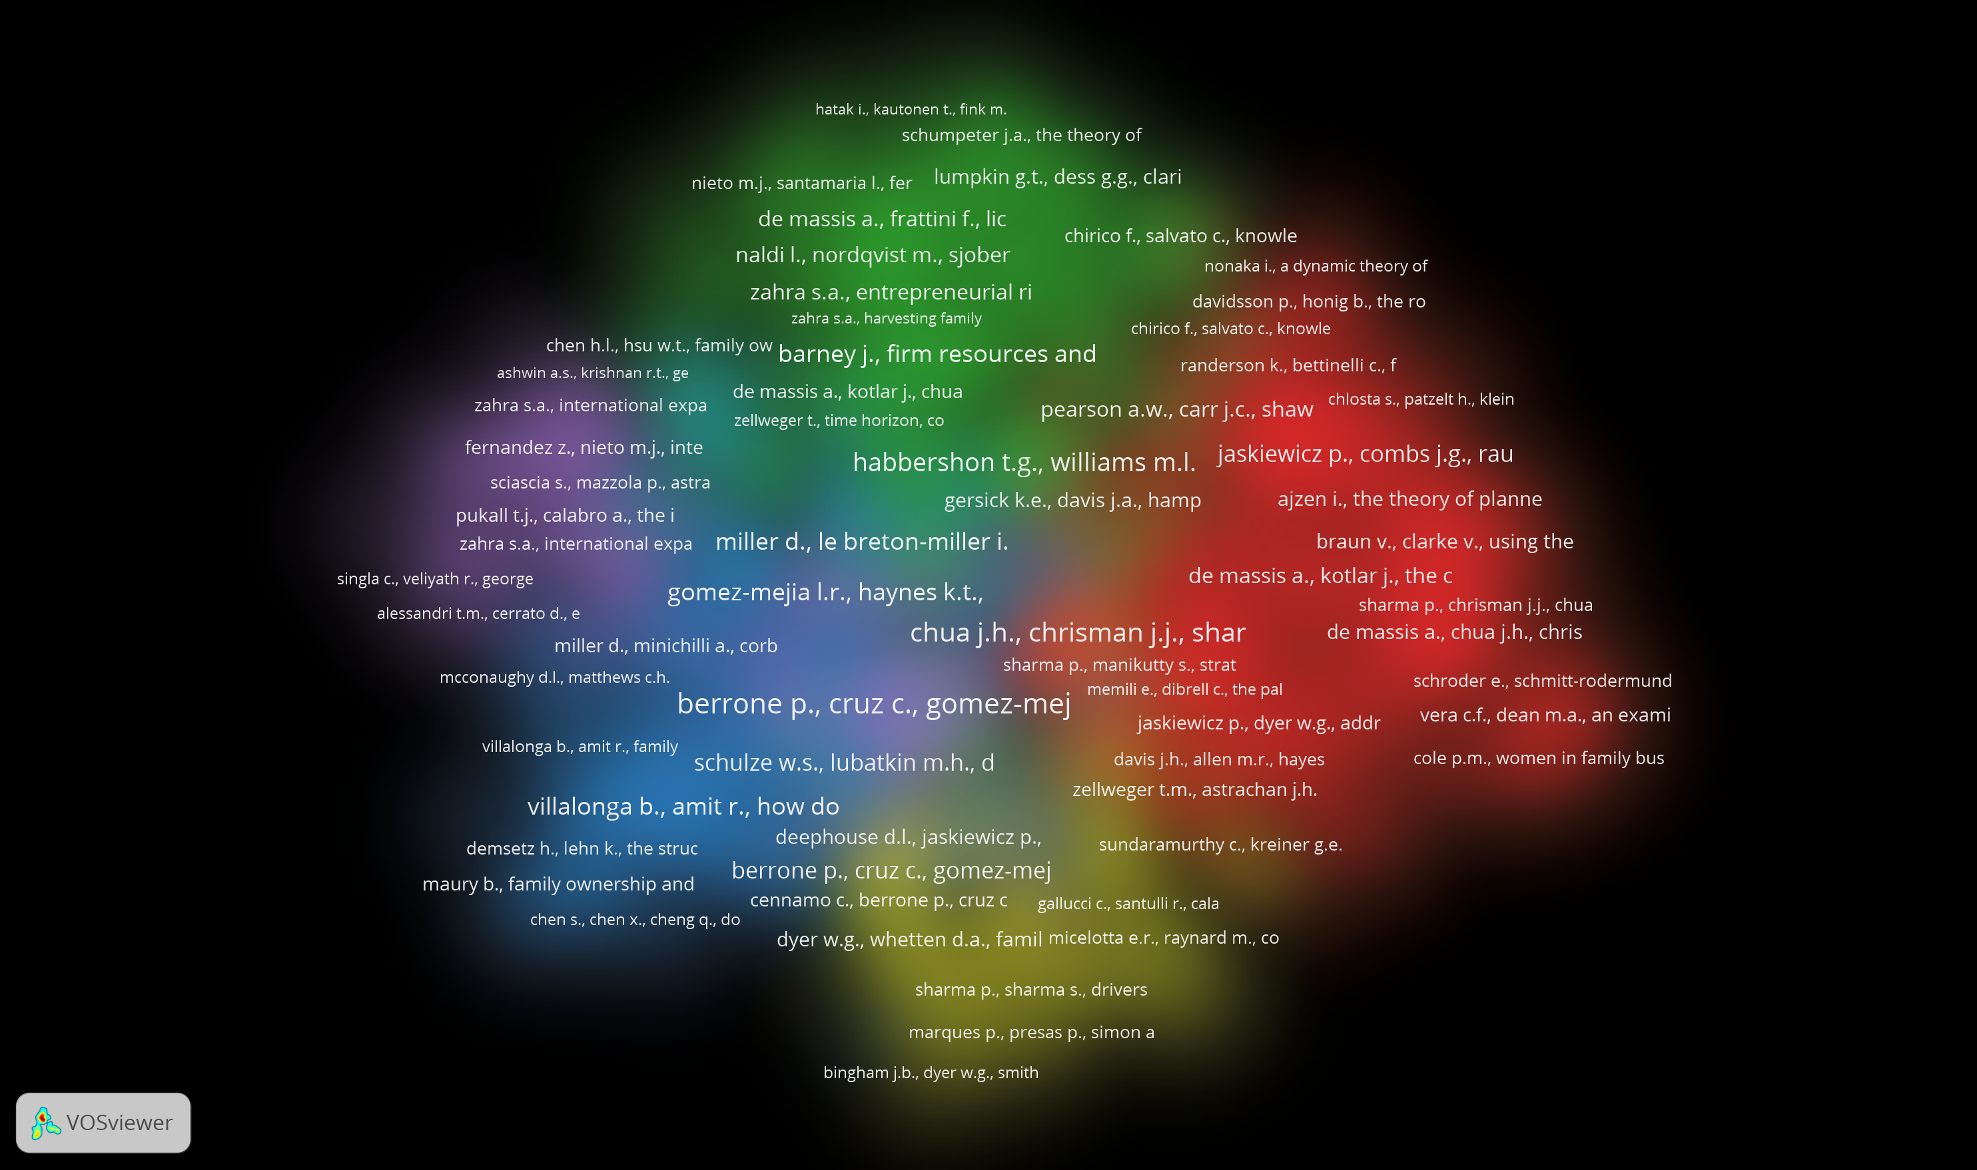
Co-Citation and Cited References Density Visualization

Slide 19
Conclusion
In this bibliography analysis, we examined the intersection of marketing analytics and family businesses through a detailed review of the literature using data from Scopus and visual mapping in VOSviewer. The co-authorship, co-citation, and keyword co-occurrence maps provided valuable insights into the key players, themes, and research clusters in these fields.
Our analysis revealed that while there is growing interest in using marketing analytics within family businesses, the research remains fragmented across multiple subfields. Prominent authors and institutions have begun to form collaborative networks, but there are still gaps in connecting these efforts across different geographic regions and disciplines. Furthermore, the keyword co-occurrence map highlighted key themes like data-driven decision-making and succession planning, showing the potential for further integration of advanced analytics in family business strategies.
Overall, this analysis underscores the importance of bridging the gap between marketing analytics and family business studies. Future research should aim to deepen the exploration of how data-driven tools can enhance the unique dynamics of family-run enterprises, addressing the existing gaps and expanding the scope of collaboration within this growing area of study.

Slide 20
References
Scopus Database. (Accessed [Date]). Available at: www.scopus.com
Van Eck, N.J., & Waltman, L. (2010). Software survey: VOSviewer, a computer program for bibliometric mapping. Scientometrics, 84(2), 523–538.

Slide 21
Questions are welcome.
Notes:
You can use this slide as your opening or closing slide. Should you choose to use it as a closing, make sure you review the main points of your presentation. One creative way to do that is by adding animations to the various graphics on a slide. This slide has 4 different graphics, and, when you view the slideshow, you will see that you can click to reveal the next graphic. Similarly, as you review the main topics in your presentation, you may want each point to show up when you are addressing that topic.
Add animation to images and graphics:
Select your image or graphic.
Click on the Animations tab.
Choose from the options. The animation for this slide is “Split”. The drop-down menu in the Animation section gives even more animations you can use.
If you have multiple graphics or images, you will see a number appear next to it that notes the order of the animations.
Note: You will want to choose the animations carefully. You do not want to make your audience dizzy from your presentation.

Slide 22


